Slide 1
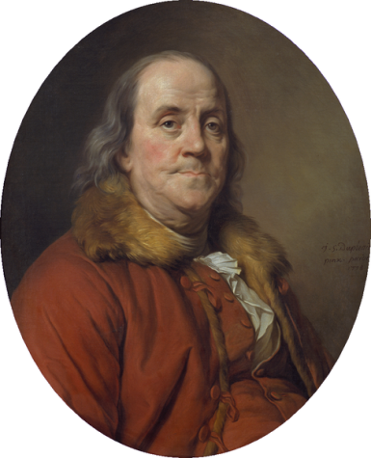
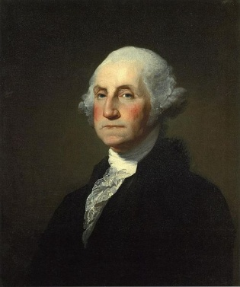
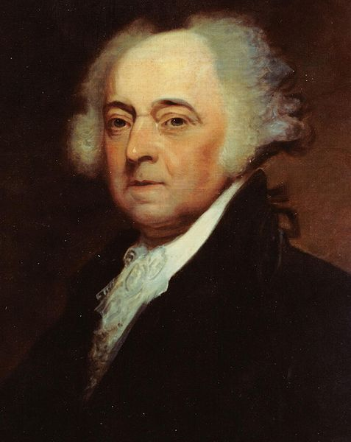
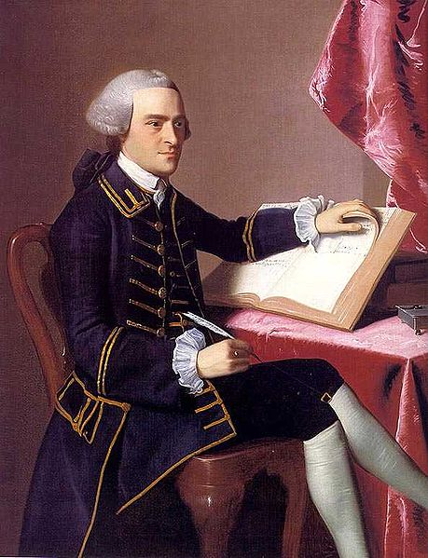
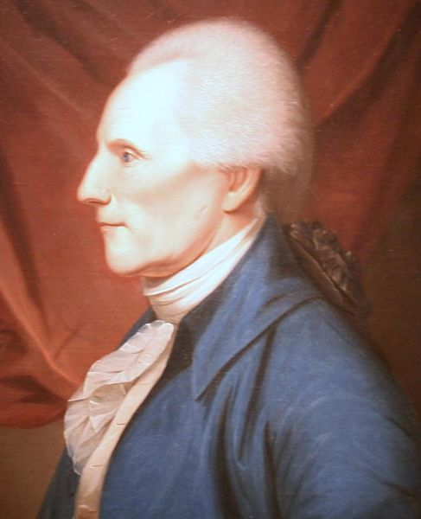
People Who Influenced the Founding Fathers

Slide 2
As you view this slide show you will fill out the Frayer Model.
John Locke
Ideas –
Connection -
Montesquieu
Ideas –
Connection -
People who Influenced our Founding Fathers
Thomas Paine
Ideas -
Connection -
What do they all
have in common?

Slide 3
When you see the following icon:
Write what it says under “Ideas” on your paper for that person
I

Slide 4
What do you mean “influence”?
The power to affect persons or events
Examples of influential people:

Slide 5
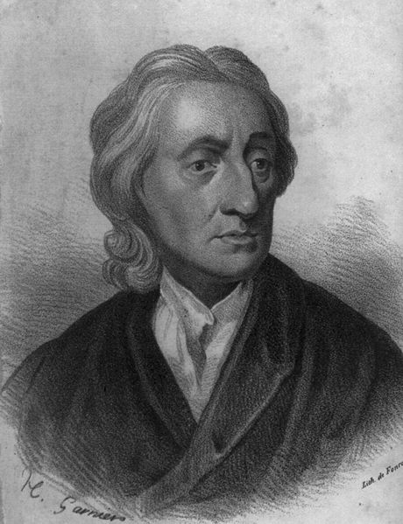
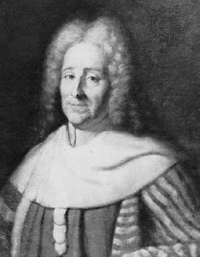
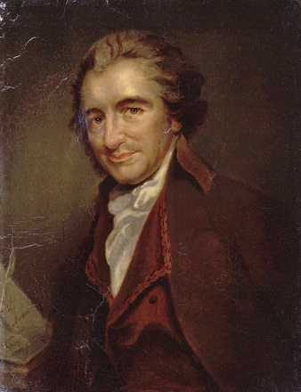
Who influenced the Founding Fathers?
We are going to focus on three important people from the Enlightenment and early America:
  John Locke and Baron de Montesquieu
  Thomas Paine

Slide 6


Let’s take a trip back in time.
2013
1687

Slide 7
What is the Enlightenment?
It was a time in history when certain thinkers and writers believed they knew more than other people and set off to “enlighten” them.
They believed the power of reason could be used to help government and build a better world.

Slide 8
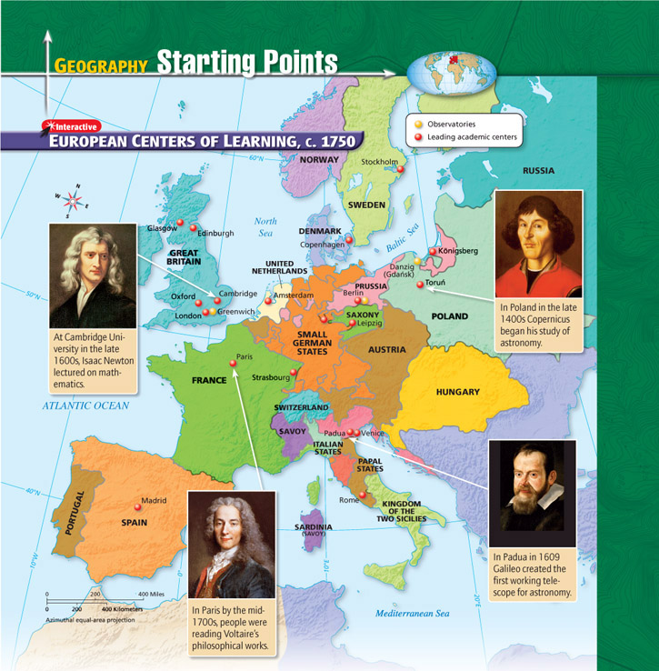
Where was the Enlightenment?

Slide 9
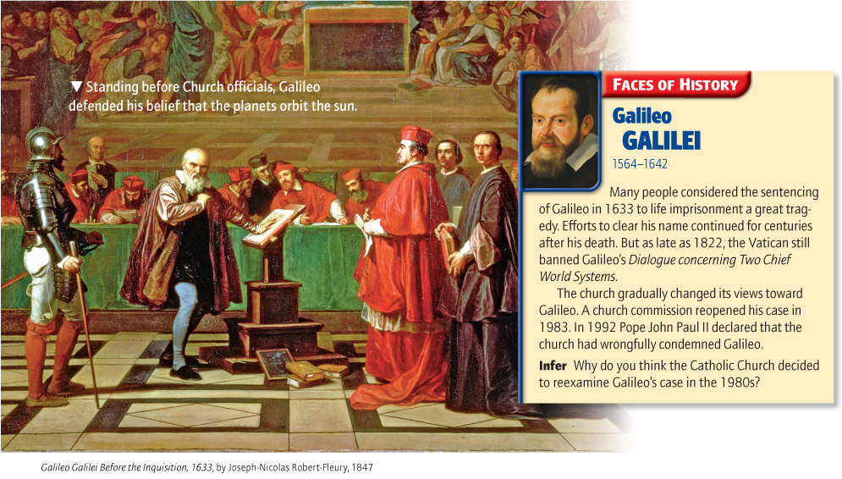
So What?
During this time government, science and people were ruled by religion; therefore unless the Church said it was okay then it didn’t happen.

Slide 10

Born in England during the year 1632
Went to college and became a physician or doctor
Met a man very powerful in government, and became his assistant
So what does this have to do with influencing our Founding Fathers?

Slide 11
Locke had many ideas that challenged the King’s authority, and he made them very known in his writings
He believed all people were born equal, and no one is above the law (everyone obeys the law)
These were not new ideas, but helped to form modern democracy
I

Slide 12
In one of his writings he states his theory of natural rights (life, liberty, and property of people) and people have the right to pursue what they want without interference
He felt the laws of the land should be based on these rights, and if they are not followed then the people had the right to rebel
I

Slide 13
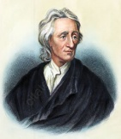
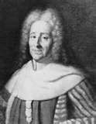

John Locke
Ideas – no one is above the law; everyone has natural rights (life, liberty, & right to own property); laws should be based on these rights
Connection -
Montesquieu
Ideas –
Connection -
People who Influenced our Founding Fathers
Thomas Paine
Ideas -
Connection -
What do they all
have in common?

Slide 14
John Locke
Ideas – no one is above the law; everyone has natural rights (life, liberty, & right to own property); laws should be based on these rights
Connection - the Founding Fathers used his ideas to based our laws on; life, liberty, and the pursuit of happiness is even written in the Declaration of Independence
Montesquieu
Ideas –
Connection -
People who Influenced our Founding Fathers
Thomas Paine
Ideas -
Connection -
What do they all
have in common?

Slide 15
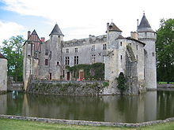
Montesquieu
Born into nobility in France
Studied law and was apart of the French Parliament
He wrote a book called the “Persian Letters” which described most of what he disliked about the French government

Slide 16
Montesquieu
Formed the idea of the separation of power within government
He felt power should be divided into 3 parts and each should check on the others
This kept an individual or a group from having too much power
I
I

Slide 17
John Locke
Ideas – no one is above the law; everyone has natural rights (life, liberty, & right to own property); laws should be based on these rights
Connection - the Founding Fathers used his ideas to based our laws on; life, liberty, and the pursuit of happiness is even written in the Declaration of Independence
Montesquieu
Ideas – formed the idea of separation of power in gov’t; should be divided into 3 parts with each one checking on the other
Connection -
People who Influenced our Founding Fathers
Thomas Paine
Ideas -
Connection -
What do they all
have in common?

Slide 18
John Locke
Ideas – no one is above the law; everyone has natural rights (life, liberty, & right to own property); laws should be based on these rights
Connection - the Founding Fathers used his ideas to based our laws on; life, liberty, and the pursuit of happiness is even written in the Declaration of Independence
Montesquieu
Ideas – formed the idea of separation of power in gov’t; should be divided into 3 parts with each one checking on the other
Connection – Our government d used this idea and we have the L Legislative, Executive and
Judicial Branches
People who Influenced our Founding Fathers
Thomas Paine
Ideas -
Connection -
What do they all
have in common?

Slide 19
Let’s Fast Forward to the future.
1776
1687

Slide 20
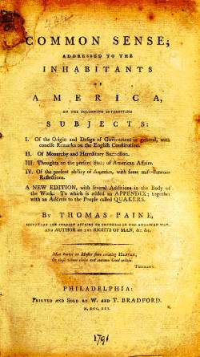
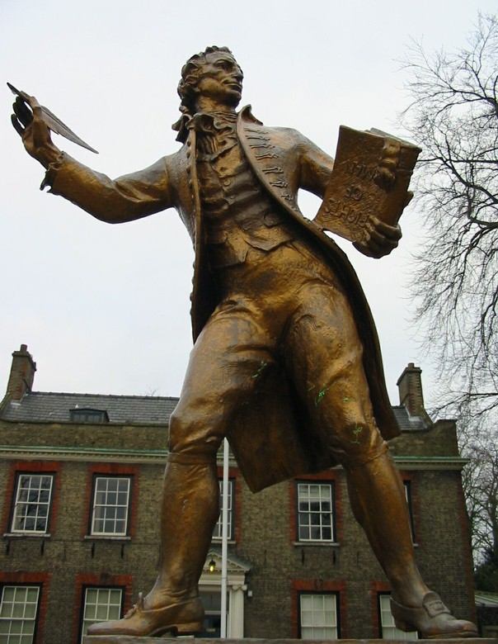
Thomas Paine: Common Sense

Slide 21
Thomas Paine
Poorly educated
Unsuccessful at most of his jobs
After being fired as a tax collector he moved to Philadelphia (the birthplace of our nation)
How can someone with these qualities influence the people of America?

Slide 22
Thomas Paine
Unlike John Locke and Montesquieu, Paine was not a philosopher
He put the ideas everyone was feeling into a 47 page pamphlet (small book)
It sold ½ million copies!
It made a powerful argument for independence from Great Britain
I

Slide 23
What did it say?
Biggest aspect of this pamphlet…it was written in a style for common people to understand
Even if Britain were the "mother country" of America, that made her actions all the more horrendous, for no mother would harm her children so brutally
It called the King “a royal brute”
Stated that a continent should not be controlled by an “island”
America would be dragged into “unnecessary” European Wars
The distance was too great. For the colonies to send a petition to Parliament it would take a year for a response
He even had a layout for the Constitution of America
I
I
Notes:
He wrote it in Biblical format and did not use Latin

Slide 24
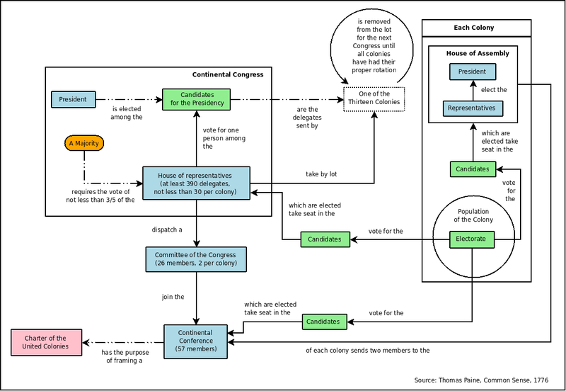

Slide 25
John Locke
Ideas – no one is above the law; everyone has natural rights (life, liberty, & right to own property); laws should be based on these rights
Connection - the Founding Fathers used his ideas to based our laws on; life, liberty, and the pursuit of happiness is even written in the Declaration of Independence
Montesquieu
Ideas – formed the idea of separation of power in gov’t; should be divided into 3 parts with each one checking on the other
Connection – Our government d used this idea and we have the L Legislative, Executive and
Judicial Branches
People who Influenced our Founding Fathers
Thomas Paine
Ideas – made a powerful
argument for America to break
away from England; wrote a book
About independence for all people to
Read; had a layout for government
Connection -
What do they all
have in common?

Slide 26
John Locke
Ideas – no one is above the law; everyone has natural rights (life, liberty, & right to own property); laws should be based on these rights
Connection - the Founding Fathers used his ideas to based our laws on; life, liberty, and the pursuit of happiness is even written in the Declaration of Independence
Montesquieu
Ideas – formed the idea of separation of power in gov’t; should be divided into 3 parts with each one checking on the other
Connection – Our government d used this idea and we have the L Legislative, Executive and
Judicial Branches
People who Influenced our Founding Fathers
Thomas Paine
Ideas – made a powerful
argument for America to break
away from England; wrote a book
About independence for all people to
Read; had a layout for government
Connection - The writings of the book inspired many Americans to revolt against the British government
What do they all
have in common?

Slide 27
John Locke
Ideas – no one is above the law; everyone has natural rights (life, liberty, & right to own property); laws should be based on these rights
Connection - the Founding Fathers used his ideas to based our laws on; life, liberty, and the pursuit of happiness is even written in the Declaration of Independence
Montesquieu
Ideas – formed the idea of separation of power in gov’t; should be divided into 3 parts with each one checking on the other
Connection – Our government d used this idea and we have the L Legislative, Executive and
Judicial Branches
People who Influenced our Founding Fathers
Thomas Paine
Ideas – made a powerful
argument for America to break
away from England; wrote a book
About independence for all people to
Read; had a layout for government
Connection - The writings of the book inspired many Americans to revolt against the British government
What do they all
have in common?
*All three of these
people have things in
common. Name three

